Slide 1

Predicting Fraudulent E-Commerce Transactions
Group 8
Notes:
Our Project Topic is the Analysis of Job Market Trends in the US.

Slide 2

Project Overview
Our project involved two datasets of e-commerce transactions. The smaller dataset (Version 2), which included a binary indicator of fraudulence, was used to train a machine learning model. This trained model was then applied to the larger dataset (Version 1) to predict fraudulent transactions.
The primary goal of this project was to achieve a fraud detection model with a prediction accuracy of 75% or higher. Additionally, the model’s performance was compared to the original dataset’s fraud detection accuracy to evaluate its effectiveness.

Slide 3
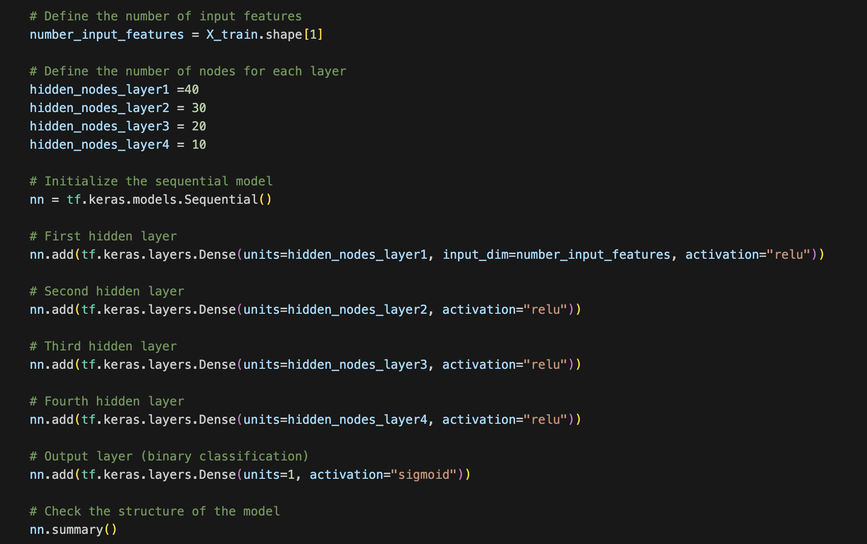
Model Architecture

Slide 4
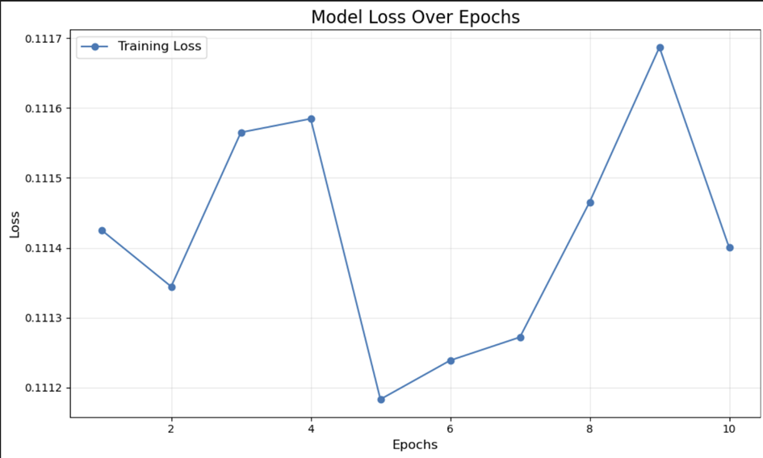
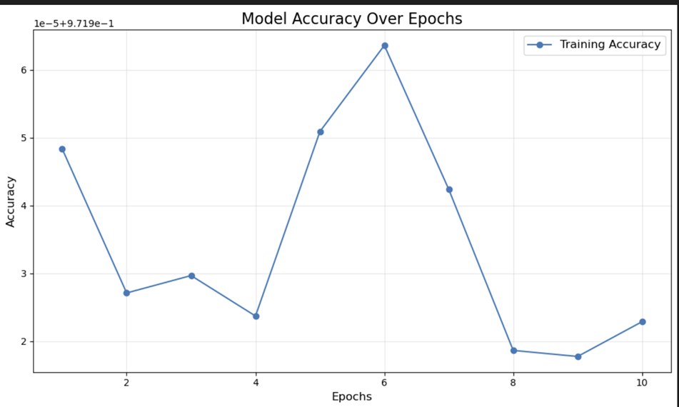
Results Visualization

Slide 5
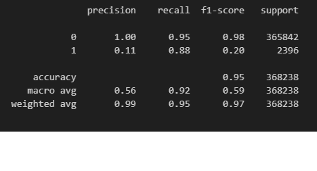
Precision, Recall, and F1-Score Analysis for Class 0 (Non-Fraudulent Transactions)
Class 0 (Non-Fraudulent Transactions)
• Precision: 1.00
The model correctly identifies all non-fraudulent transactions with no false positives.
• Recall: 0.95
95% of all actual non-fraudulent transactions are correctly identified.
• F1-Score: 0.98
A balance between precision and recall, indicating exceptional performance for this class.

Slide 6
Precision, Recall, and F1-Score Analysis for Class 1 (Fraudulent Transactions)
Class 1 (Fraudulent Transactions)
• Precision: 0.11
Only 11% of flagged fraudulent transactions are actual frauds. This low precision indicates a high number of false positives, leading to inefficiency in real-world use.
• Recall: 0.88
The model detects 88% of actual fraudulent transactions, which is a strong point.
• F1-Score: 0.20
The balance between precision and recall is poor, reflecting the low effectiveness of the model in identifying fraudulent transactions.

Slide 7
Analysis & Conclusion

Slide 8

Thank you

